Slide 1
CHANGING PLACES: in NHS Scotland
Susan Grant
NSS HFS Principal Architect
Notes:
Who knows what a Changing Place facility is ?
Who knows where the nearest one is ?

Slide 2
Changing Places consortium
Over a 1/4 million people in UK need Changing Places toilets to enable them to get out and about and enjoy the day- to-day activities many of us take for granted...”
Notes:
In 2006, the ‘Changing Places, changing lives’ campaign was launched by the Changing Places Consortium, made up of PAMIS, MENCAP, Centre for accessible environment, various councils and also Scottish Government.
This is a public facility, not a clinical one.
Public statutory duties are laid out in:
UK Equality Act (2010)
Specific Duties (Scotland) Regulations (2012)
Scottish Building Standards Regulations NDTH cl 3.12 (2013)
BS 8300:2009 (2010)
These state public authorities, including NHSScotland, must have 'due regard' to the need to eliminate unlawful discrimination, advance equality of opportunity and foster good relations. This requires an integrated response across services, facilities, training and communications to ensure the characteristics protected by the Act are appropriately served. An Equality Impact Assessment (EIA) is required for all proposed investments.
In summary there is a statutory requirement on NHS Scotland to provide “appropriate provision of facilities for all sections of our communities”.

Slide 3
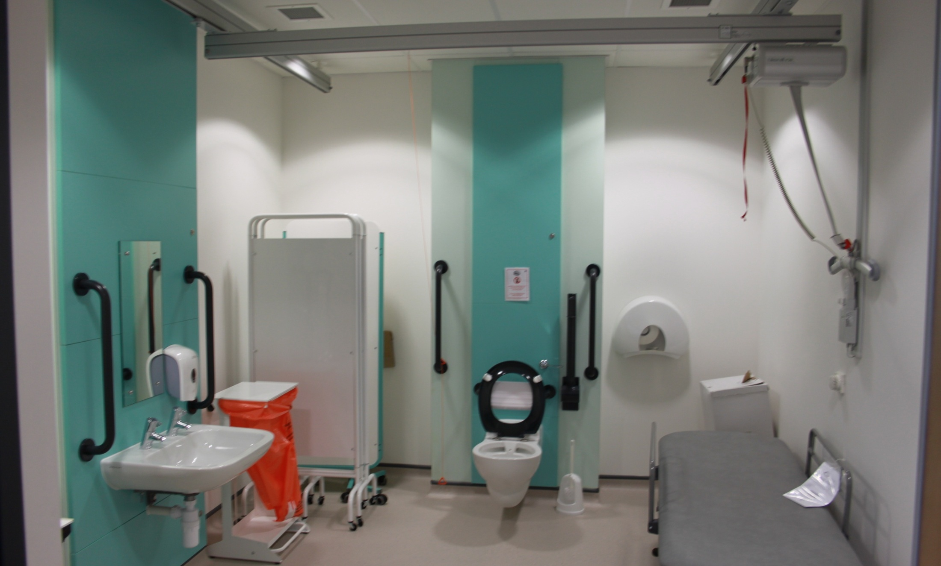
What are Changing Places ?
Changing Place facility at Aberdeen Care Village, NHS Grampian.
Notes:
A CP facility must include:
-height adjustable, adult-sized changing bench
- ceiling track hoist system
- adequate space for the disabled person and up to two assistants
- centrally located toilet with space both sides for assistants
- privacy screen
- wide paper roll
- large waste disposal bin
- washbasin, preferably height adjustable
However they are more than a just an inconveniently big public WC
For up to 25,000 residents of Scotland, this 3 x 4m can mean the freedom from virtual house arrest!

Slide 4
Why are CP toilets important ?
thousands of people with profound and multiple learning disabilities, as well other disabilities that severely limit mobility, cannot use standard accessible toilets;
it is not acceptable, safe, hygienic, dignified, for a significant proportion of the population to have to resort to a changing mat on an accessible toilet floor;
although the numbers are increasing, there are still not enough Changing Places toilets across the country;
a higher proportion of NHS users need access to CP toilets; plus NHS facilities are well located/ open.
everyone has a right to live in the community, to move around within it, and access all its facilities.
Notes:
Imagine having to change your son, daughter or partner on the floor of a public toilet.
Imagine how you would feel if you were , that person on that floor. Sadly there are thousands of disabled people and families who do not have to use their imagination. For them, this is a daily reality.
Research shows ~250,000 across the UK , therefore up to 25,000 in Scotland need CP toilets.

Slide 5
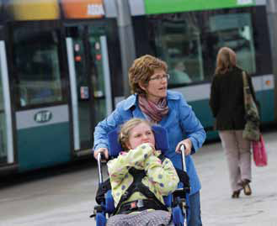
Who are CP toilets for ?
In the UK the number of people who would benefit from a Changing Places toilet would include approx*:
40,000 profound/multiple learning disabilities
130,000 older people
30,000 cerebral palsy
13,000 acquired brain injury
8,500 Multiple Sclerosis
8,000 Spina Bifida
500 Motor Neurone Disease
*Estimates of potential CP toilet users
Professor James Hogg, Dundee University Report (2009)
Notes:
CP toilets are for anyone between 5 and a 105, who need personal assistance to use the toilet or change continence pads, including people with profound and multiple learning disabilities, spinal injuries or living with stroke.
This photo shows Lowri who is 12 years old and has Rett Syndrome. She is a wheelchair user with no independent mobility and needs complete 24hr support. Lawri wears continence pads, which need to be changed in a CP toilet. Thanks to the installation of CP toilets in the local area, Lowri’s mum, Bethan, has been able to take the whole family out and stay out for longer. She says:
“I was able to take Elin and Lowri shopping for school clothes in the morning, have lunch and then go straight on to the theatre, just like anyone else would have done.”

Slide 6
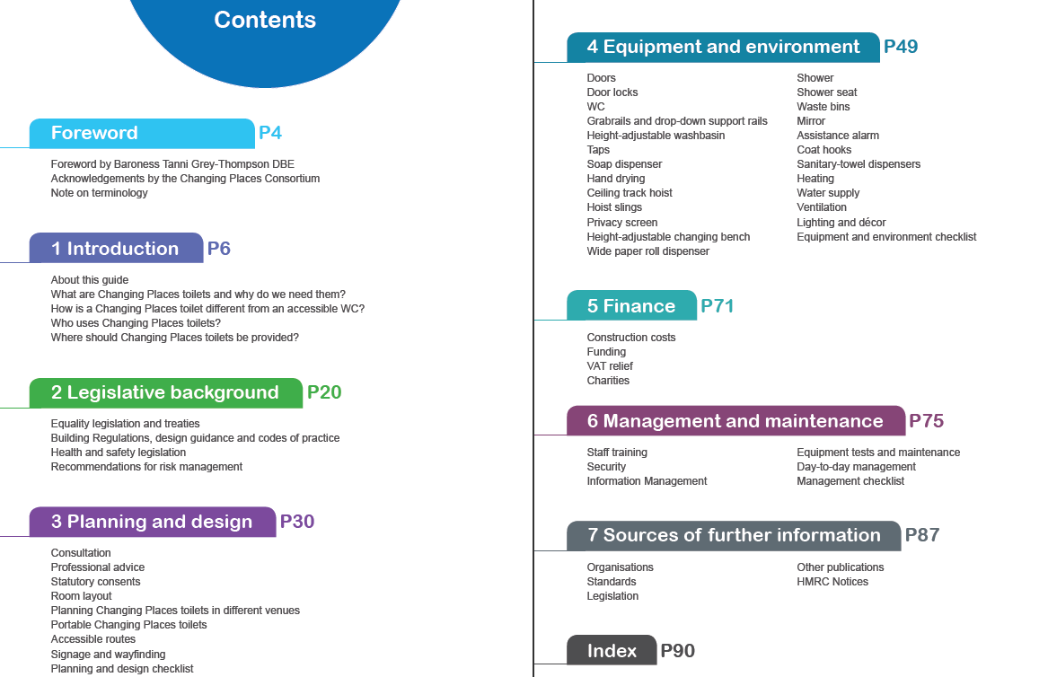
What do Changing Places need ?
www.changing-places.org provides real life stories, and detailed practical guidance on CP toilets.
HBN 00-02 Sanitary spaces
Changing Places contact:
.Julie Taylor PAMIS information officer . 15/16 Springfield; Dundee University | . DD1 4JE; T: 01382 384 953 . www.pamis.org.uk
CP toilets to be installed in all big public places, and listed in online register/ map.
Notes:
Update since last issue: new section 5.74 Changing Places facility, and reference to detailed design and registration requirements, which are available from www.changing-places.org.
“Changing Places facilities are primarily for public not clinical use, as are general accessible toilets, their functions should not normally be combined. The quantity and location for both should be considered for all new public investment under an Equality Impact Assessment (EIA). It is anticipated that the population of Scotland served by majority of NHSScotland campuses, would require a Changing Places facility, as well as general accessible toilets, baby changing, gender neutral facilities, together with inclusive, dementia and age appropriate design inside and out.“

Slide 7
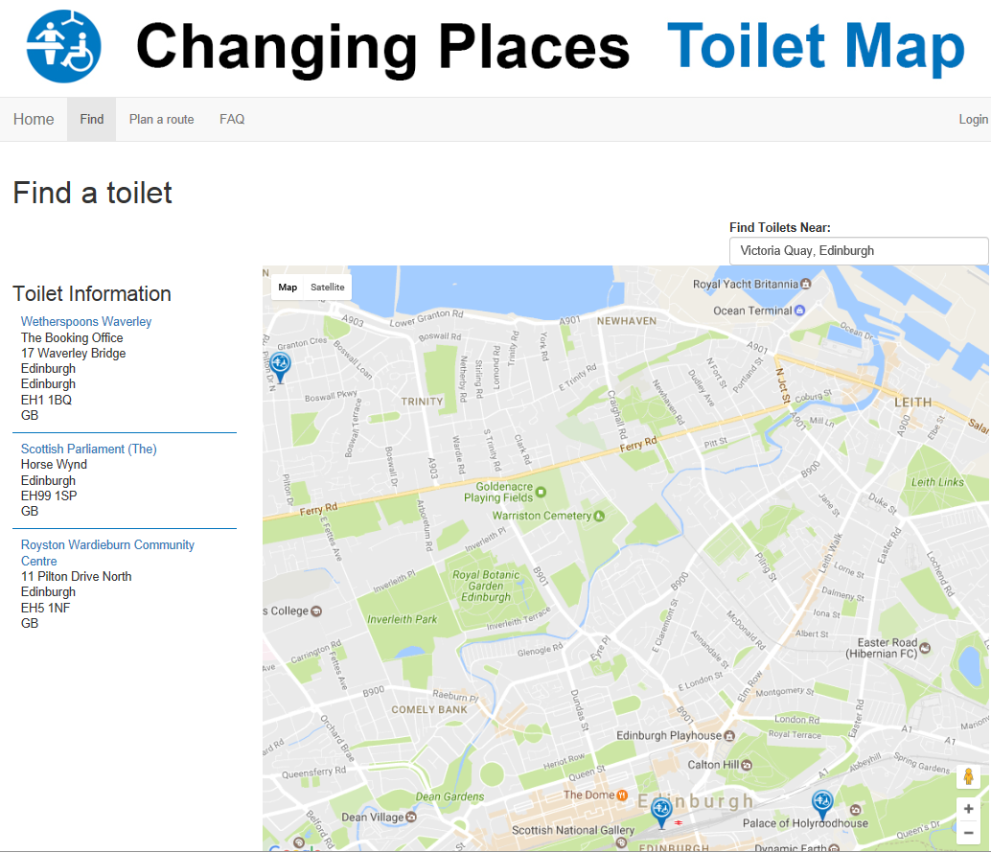
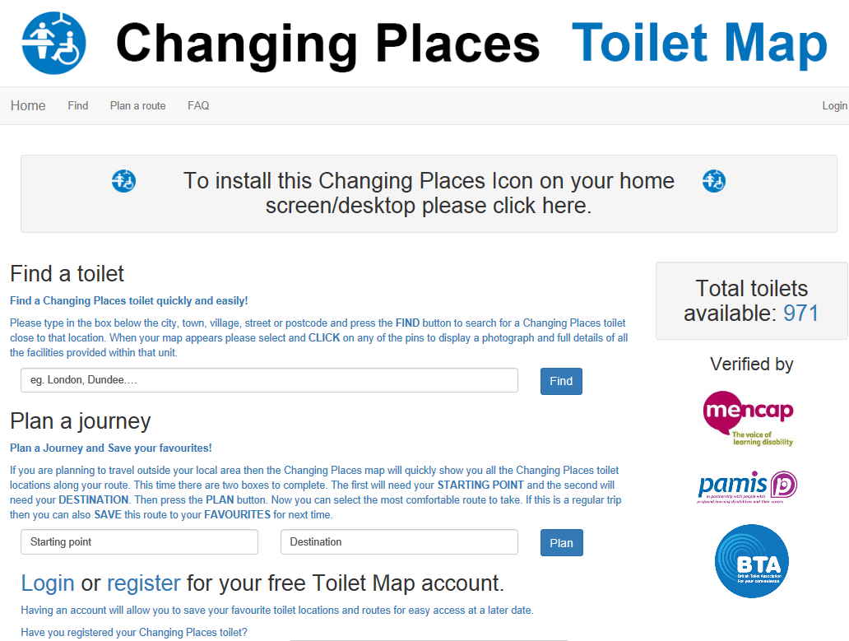
How to find a CP toilet ?
Notes:
Closest Changing Places toilet to here, is at least 2.5miles away, at either Weatherspoons, Waverly Station / or Scottish Parliament.
Across all NHSScotland, only 10no toilets listed on Changing Places website, but we believe should be circa 18no in reality.
Julie stated on her visits so far, some unknown to staff/ missing equipment/ used as storage etc, others just need registered, which is free.
I have passed on to Julie further circa12no planned in our current new build investments...
However there is much more to do, as still large sections of our communities are without “appropriate provision of facilities for all”.
We need to strategically plan, and ensure we consider CP provision in our NHS Scotland future investment proposals for both existing campuses, as well as new builds.
I will support progress on this wherever possible, and it will be monitored through the SCIM and the NDAP Design Assessment Process.
The story I heard that sticks with me, was of a daughter unable to visit her elderly mother who was unfortunately in hospital for several weeks/ months. A mother who had looked after her and been her main carer throughout her entire life, simply due to the lack of Changing Places toilet.

